Slide 1
GUESS WHO?
- Spaak
AJ Bell
Azhad mehmood
Khoa Le
Prachi hada
Srinivas annapantula

Slide 2
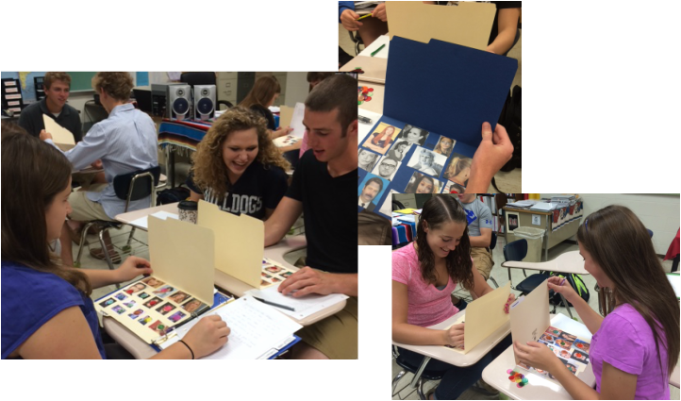
What is Guess Who?
Guess Who? is a two-player guessing game created by Ora and Theo Coster, also known as Theora Design.
Each player starts the game with a board that includes cartoon images of people and their first names with all the images standing up and each player selects one card.
The objective of the game is to be the first to determine which card one's opponent has selected.

Slide 3
Strategy for Guess Who?
Players may ask various “yes” and “no” questions to eliminate candidates.
Sample questions may include questions such as "Does this person have brown hair?“.
The player must continue eliminating candidates until only one card is remaining.
Well-crafted questions allow players to eliminate one or more possible cards.

Slide 4
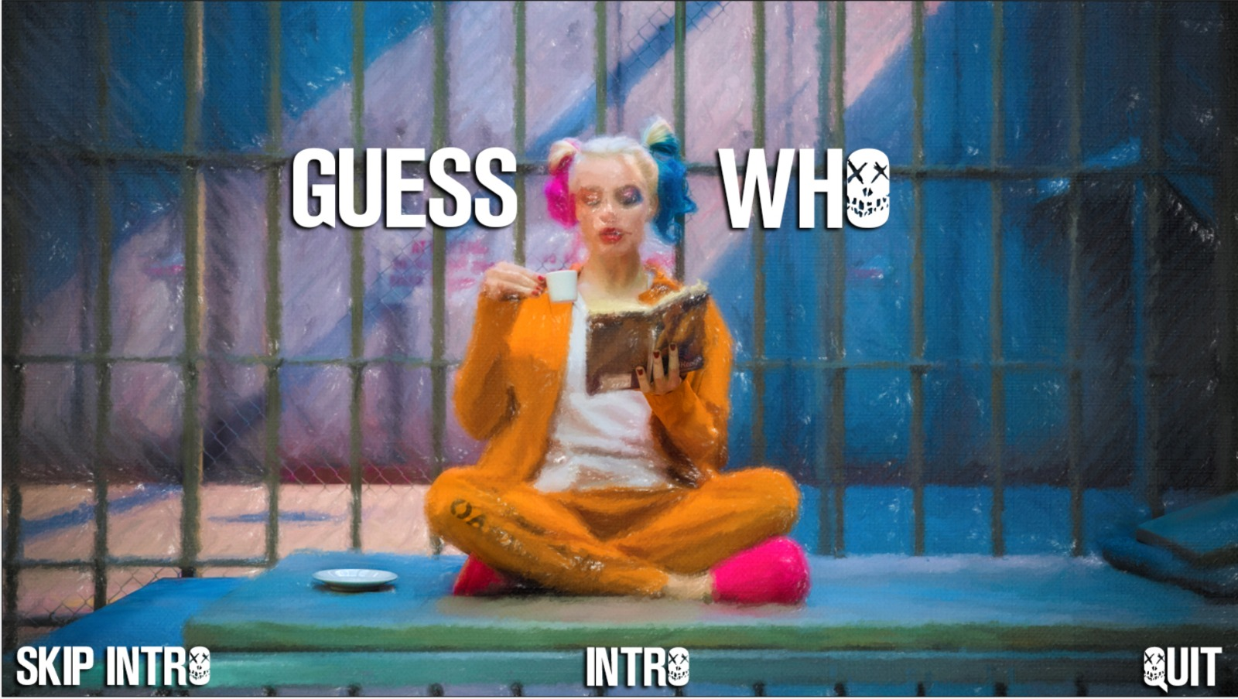
Guess Who? – The Video Game

Slide 5
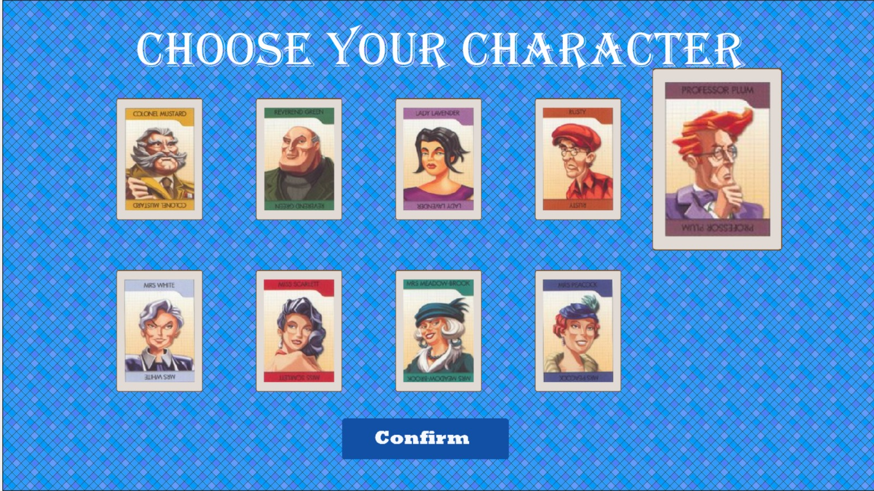
Selecting a Character
This version of Guess Who is a Multiplayer game where each player starts off by selecting their own secret character from a total of 9 available characters.

Slide 6
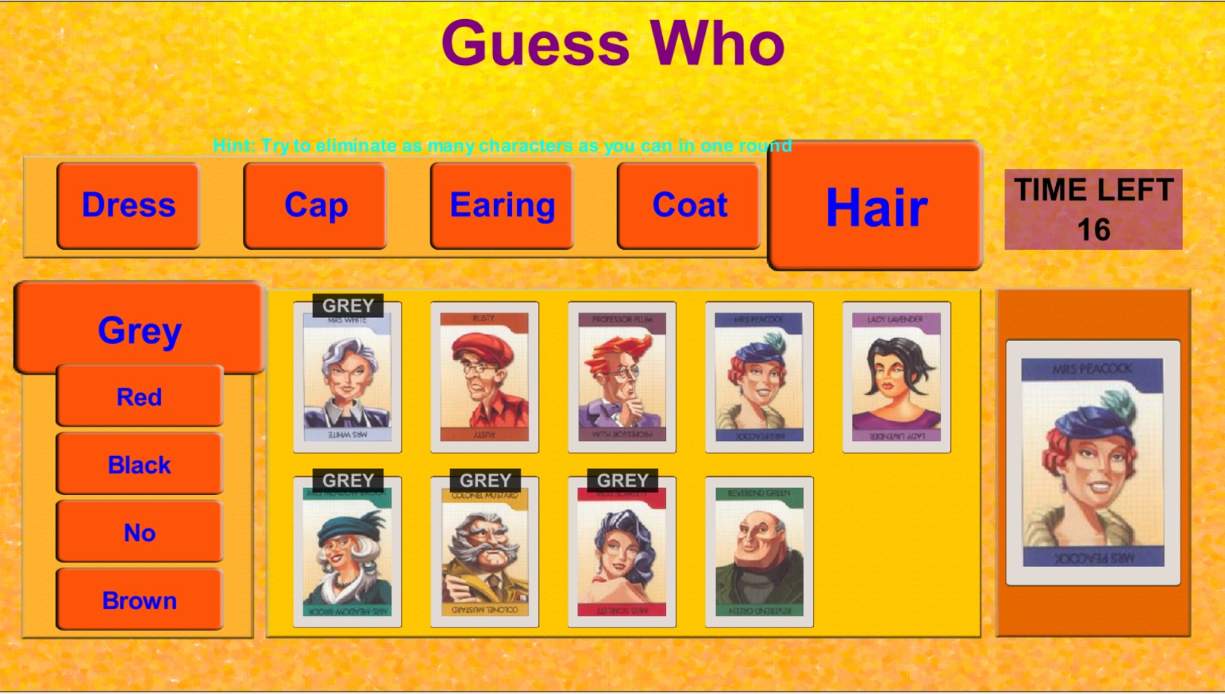
Filtering Characters
Players select the options provided on the screen to eliminate the characters.
The key to beating one’s opponent is to select the various options such that it eliminates the most characters per turn.
Each turn is of 30 seconds and each player’s responses get submitted automatically.

Slide 7
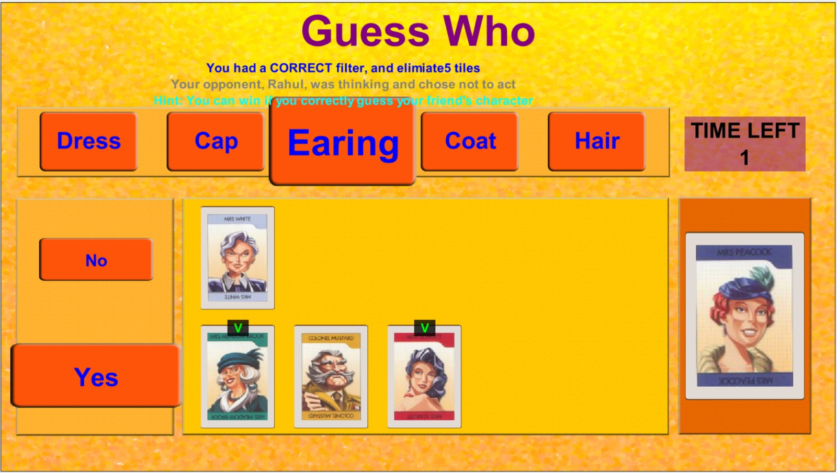
Filtering Characters (cont...)
After Eliminating as many characters as possible, the player must guess a character which the opponent may have selected.
If the guess is incorrect, then the character selected will be eliminated and the player must guess again by filtering through options or selecting character.

Slide 8
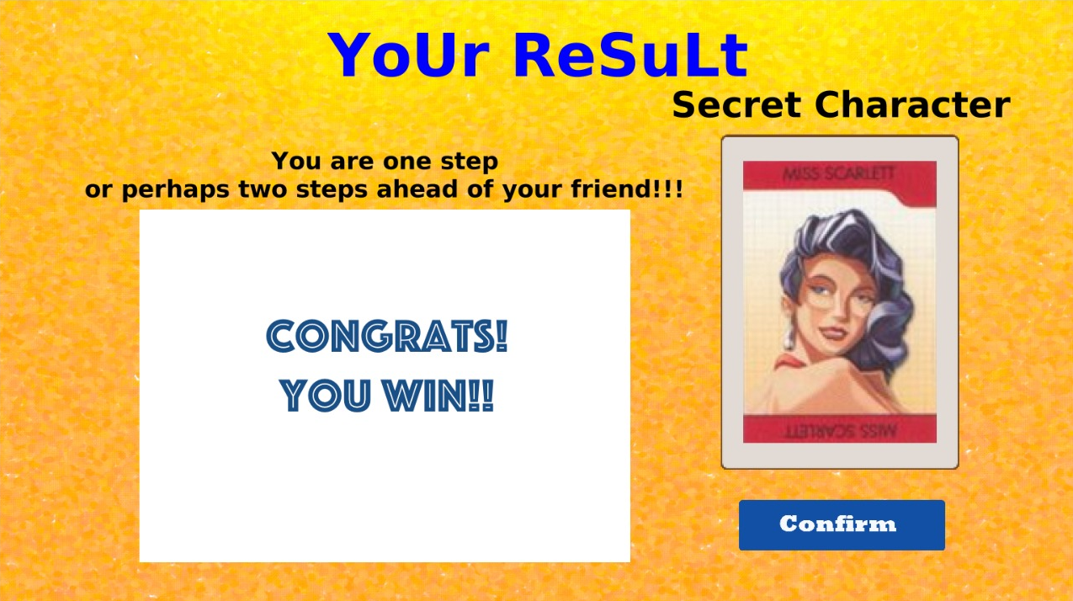
You Win!!!
If you guess your opponent’s character before he does the same, then you win.

Slide 9
Divide and Conquer Algorithm
In divide and conquer approach, the problem in hand, is divided into smaller sub-problems and then each problem is solved independently.
The solution of all sub-problems is finally merged in order to obtain the solution of an original problem.
Divide and conquer technique is the basis of efficient algorithms for all kinds of problems, such as sorting, multiplying large numbers, finding closest pairs of points.

Slide 10
Divide and Conquer Algorithm (cont..)
The purpose of the Guess Who game is to be able to determine one’s opponent’s character by eliminating other candidates in chunks each turn.
Reducing the amount of characters display each turn creates a smaller sub-problem, and so on, until the player is able to accurately guess their opponent’s character.
There are many strategies to determining the opponent's character.
Divide and conquer algorithm is the most efficient way to guess your opponent’s character within the least amount of turns by eliminating as much as half of the choices.

